Slide 1
Multi-Agent Grid Coverage
Sushovit Nanda (21283)

Slide 2
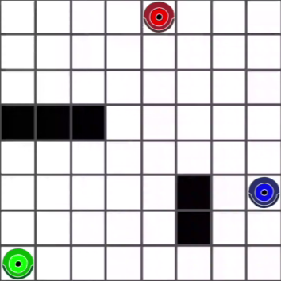
Problem Statement
In a dynamic multi-agent environment, multiple autonomous agents are placed on a 10x10 grid (with / without obstacles). The objective is to use a reinforcement learning framework that enables these agents to explore and completely cover the grid, ensuring that each cell is visited exactly once.
Fig. 1 : An example 8x8 environment with 3 agents and obstacles

Slide 3
Challenges in the Problem
The key challenges are to:
Coordinate the agents' movements such that they avoid overlapping and revisiting previously visited cells.
Achieve efficient exploration among the agents while ensuring that no agent interferes with the others' progress.
Develop and apply reinforcement learning solution to train the agents for optimal, collision-free grid coverage.
The task requires balancing exploration and coordination in a dynamic environment while maintaining computational efficiency and achieving full grid coverage.

Slide 4
Chosen Algorithm – Q-Learning
Q-learning doesn’t require prior knowledge of the environment, making it suitable for dynamic and partially observable environments.
Epsilon-greedy action selection ensures a balance between discovering new strategies and using learned policies to maximize rewards.
Reward shaping penalizes collisions/revisits and incentivizes new cell coverage, aligning agent goals with the problem objective.
Agents update Q-values to learn which actions maximize grid coverage while minimizing overlaps.
Independent Q-learning scales to multiple agents without requiring explicit communication or centralized control.

Slide 5
MDP Approach
States (S):
The state for each agent is its current position on the grid: S={(x,y)}, where x, y represent grid coordinates.
Actions (A):
Each agent can take one of four discrete actions (up, down, left, or right).
Actions may result in collisions, obstacle avoidance, or grid coverage.
Transition Function (P(s′∣s,a)):
Deterministic transitions: Moving to adjacent cells as per the action, unless blocked by boundaries or obstacles.
Rewards (R(s,a)):
Positive reward for visiting new cells (e.g., +10/(distance to start+1)+10 / (\text{distance to start} + 1)+10/(distance to start+1)).
Negative reward for revisiting cells (−1-1−1) or colliding with obstacles (−1-1−1).
Bonus reward for completing grid coverage (+50+50+50).
Discount Factor (γ):
Balances immediate rewards vs. long-term benefits; typically set to 0.90.90.9 to emphasize future rewards.

Slide 6
MDP Architecture
Environment:
The grid acts as the environment where agents interact, with obstacles adding constraints to movements.
Each agent perceives the environment independently.
Policy (π(a∣s)):
A policy maps a state to an action that the agent chooses, learned through the Q-Learning algorithm.
Q-Function Approximation:
Q-Values (Q(s,a)) estimate the expected cumulative reward for taking action aaa in state sss.
These are iteratively updated via the Bellman Equation.
Decentralized MDP:
Each agent operates independently, maintaining its own Q-table.

Slide 7
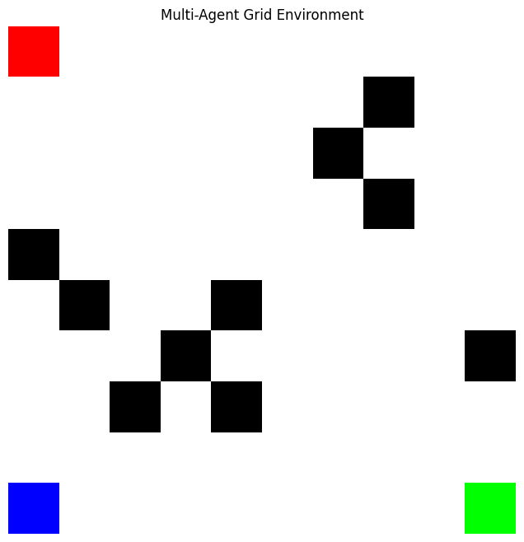
Results – Setup
Grid Size:
A fixed 10×1010 \times 1010×10 grid, where each cell can be empty, contain an obstacle or be occupied by an agent.
Agents:
N=3N = 3N=3 agents, each starting from predefined fixed positions-
Agent 1: (0,0), Agent 2: (9,0), Agent 3: (9,9)
Obstacles:
M=10M = 10M=10 randomly placed obstacles on the grid.
Agent Coverage:
Each cell is marked with the agent’s ID that first visited it. Coverage is tracked using the ‘agent_coverage’ array.
Fig. 2 : The 10x10 environment with 3 agents and 10 obstacles

Slide 8
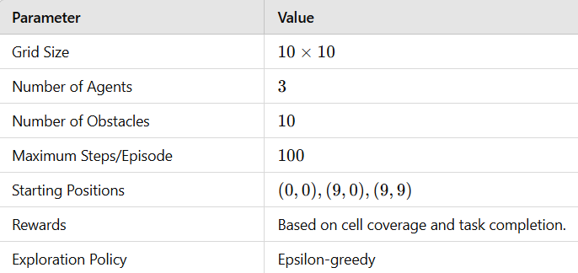
Results – Parameters
Rewards:
New Cell: +10/(distance to start position+1)
Revisited Cell: −1
Obstacle Collision: −1
Completion Bonus: +50
Steps per Episode:
Each episode is limited to a maximum of 100 steps, encouraging agents to act efficiently.
Agent Communication:
No explicit communication between agents. Coordination happens implicitly through the shared environment.

Slide 9
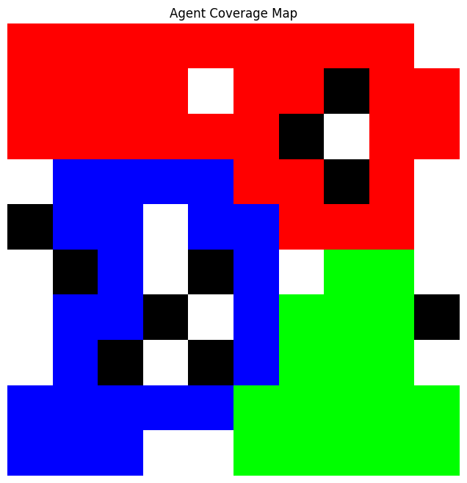
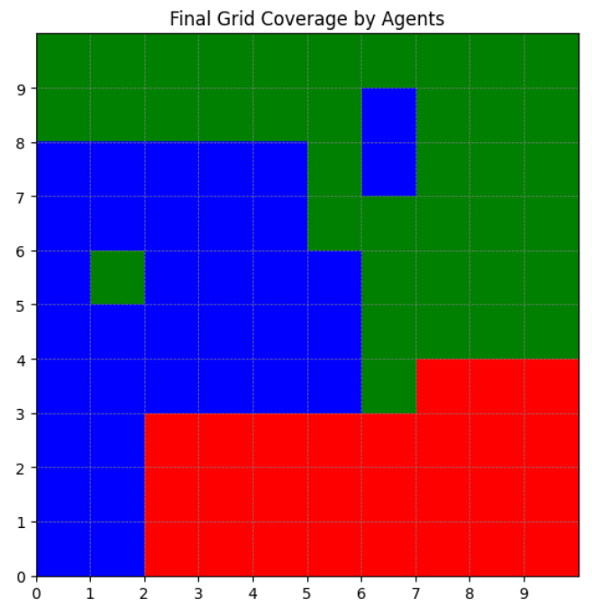
Results
Fig. 3: 10x10 environment coverage with obstacles
Fig. 4: 10x10 environment coverage without obstacles

Slide 10
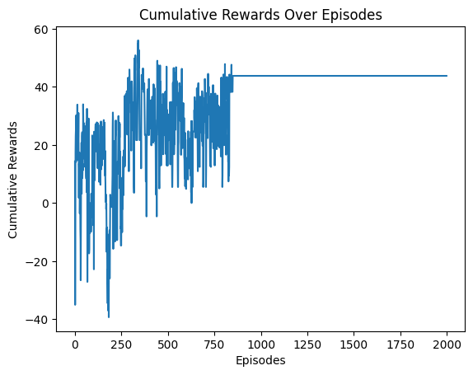
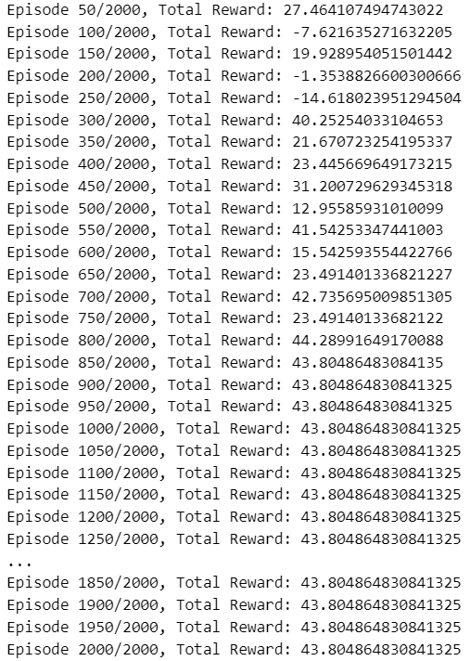
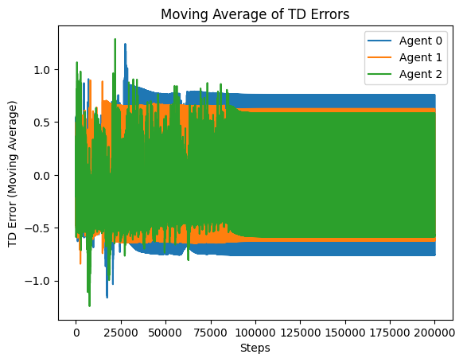
Results

Slide 11
Team Composition
Sushovit Nanda – 21283
Sai Satyam Mohapatra – 21233
All the work and experimentation presented in this presentation have been conducted solely by me. The contributions and work of my teammate are showcased in his separate presentation.

